Slide 1
Science and Stem at Cleobury Mortimer Primary School

Slide 2
What are the requirements for science in school?
The legal requirement for teaching science in school is 2.5 hours per week.
We usually teach this as a whole afternoon session as this provides the opportunity to teach the subject knowledge and consolidate, or carry out experiments and practical activities.
The requirement for science encourages children to develop subject knowledge and science based skills, such as making predictions, analysing data and investigating.

Slide 3
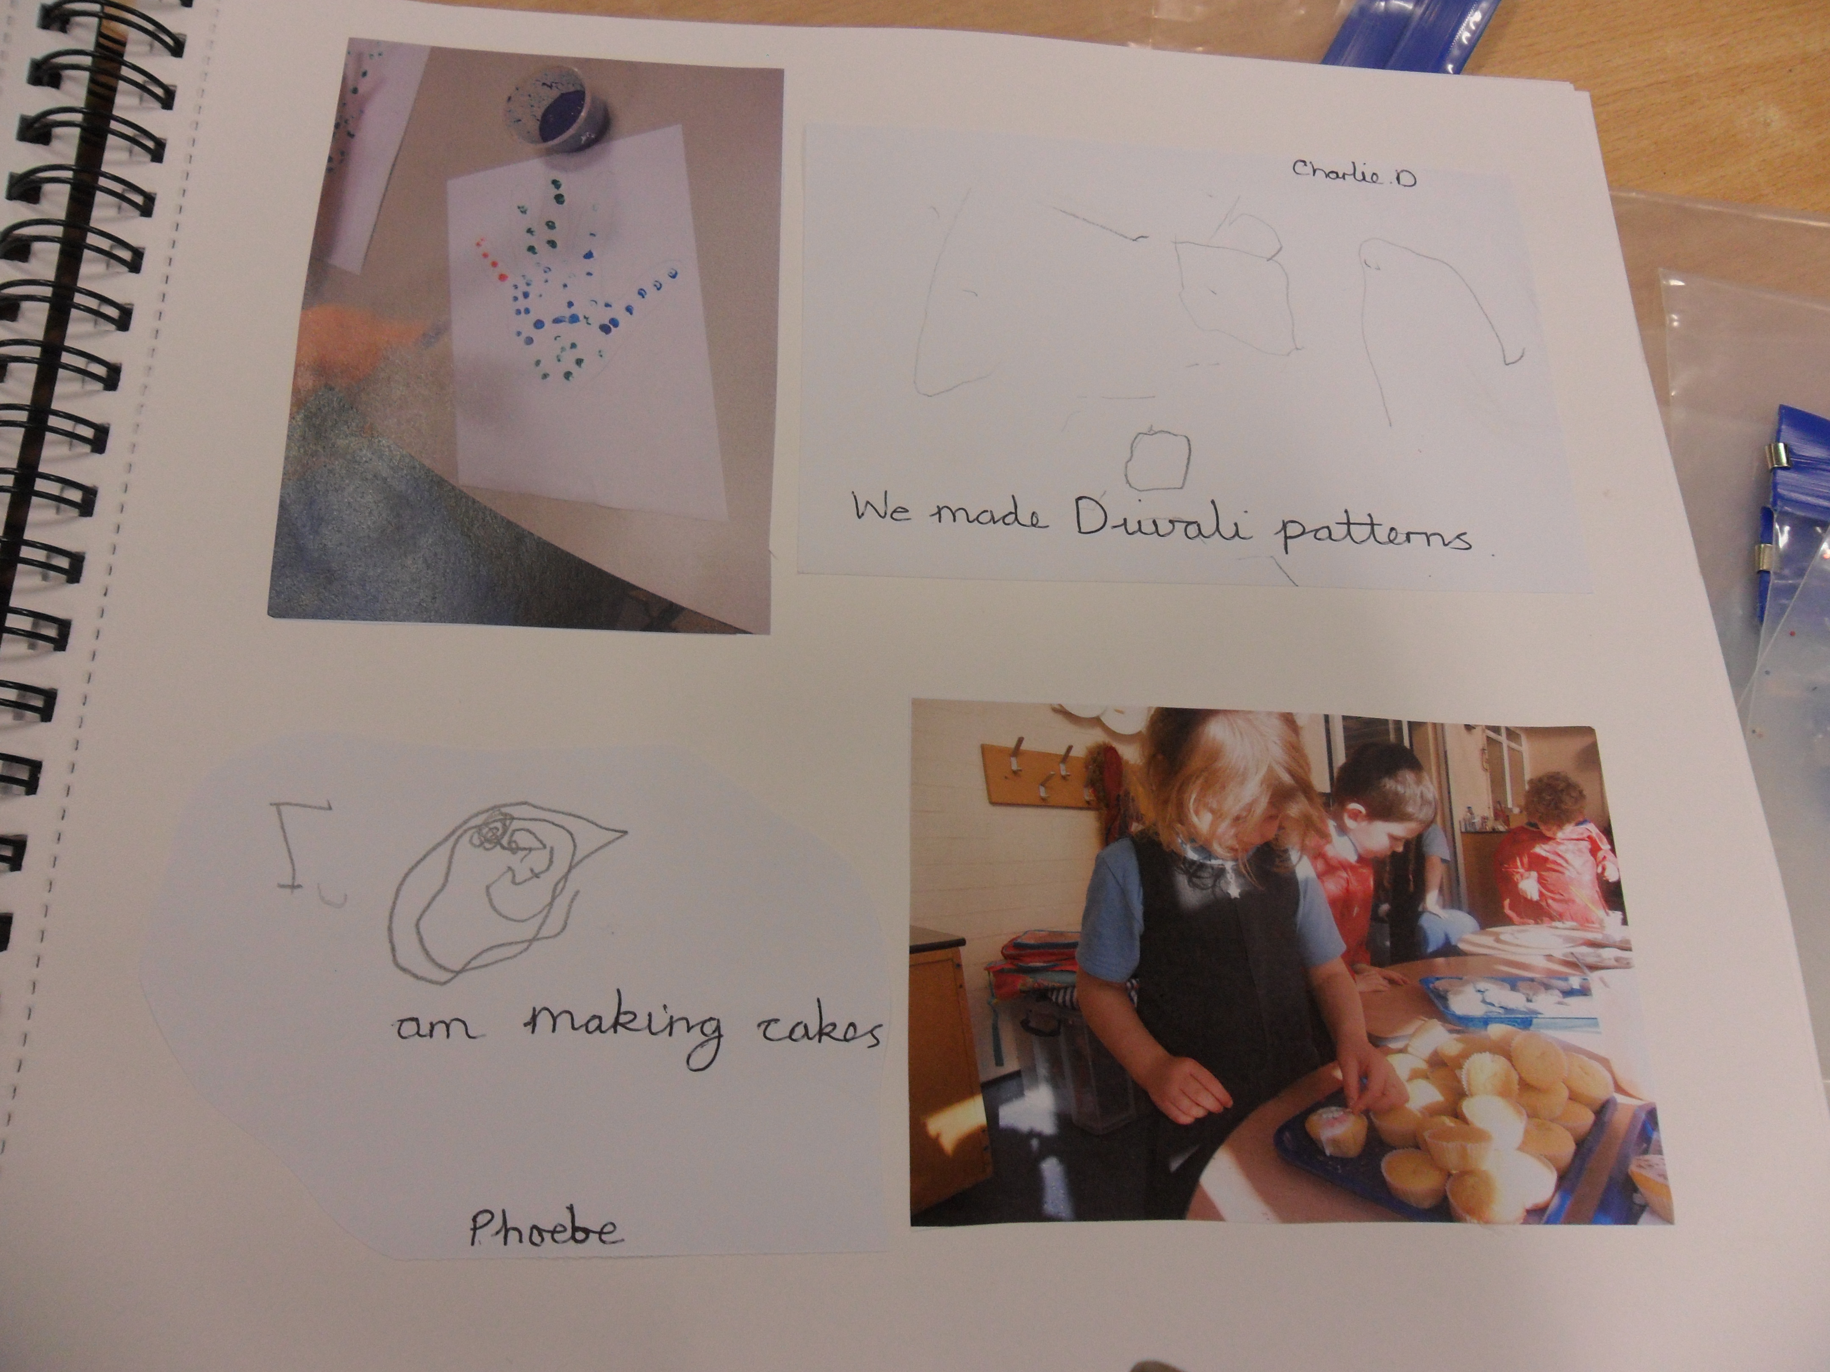
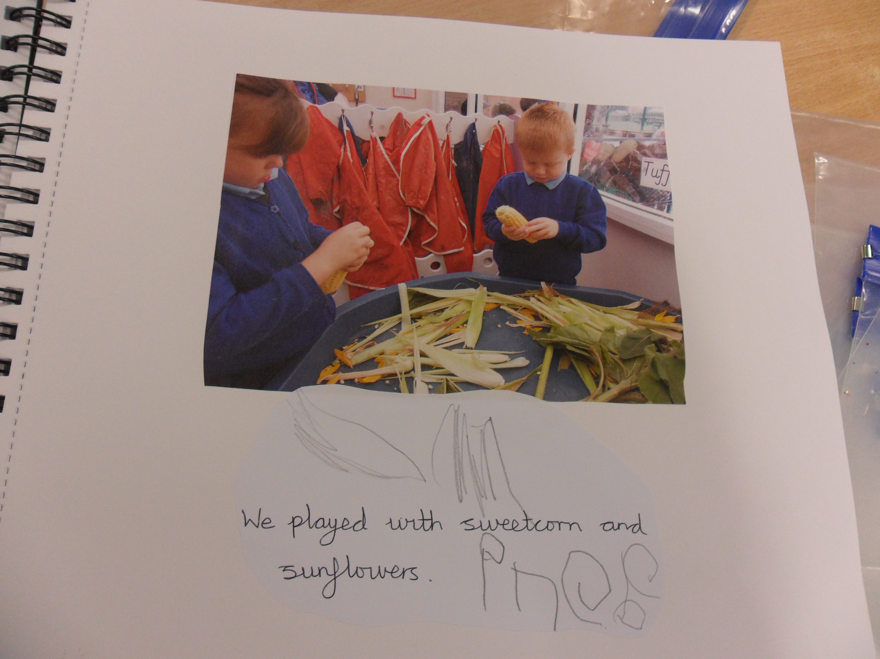
What does science look like in our school?
Early years
Science is part of developing their understanding of the world and is not taught as a specific subject.
Children’s observations and quotes are photographed and recorded by the class teacher and teaching assistants and then evidenced in the books.

Slide 4
KS1 and KS2
Science is taught through the ‘Engaging Science Programme’ which we follow.
Each unit provides planning, investigations and resources linked to the objectives, which are from the National Curriculum.
Work is evidenced through investigation recordings, photographs and write ups. We try and link science to writing when possible, so we usually aim to complete a written piece of science work at least once a term. This might be a comparison, an observation or an explanation.
The ‘Engaging Science Programme’ also provides assessment that is based on each objective that is taught and marked as BMA which teachers fill in at the end of every unit.

Slide 5
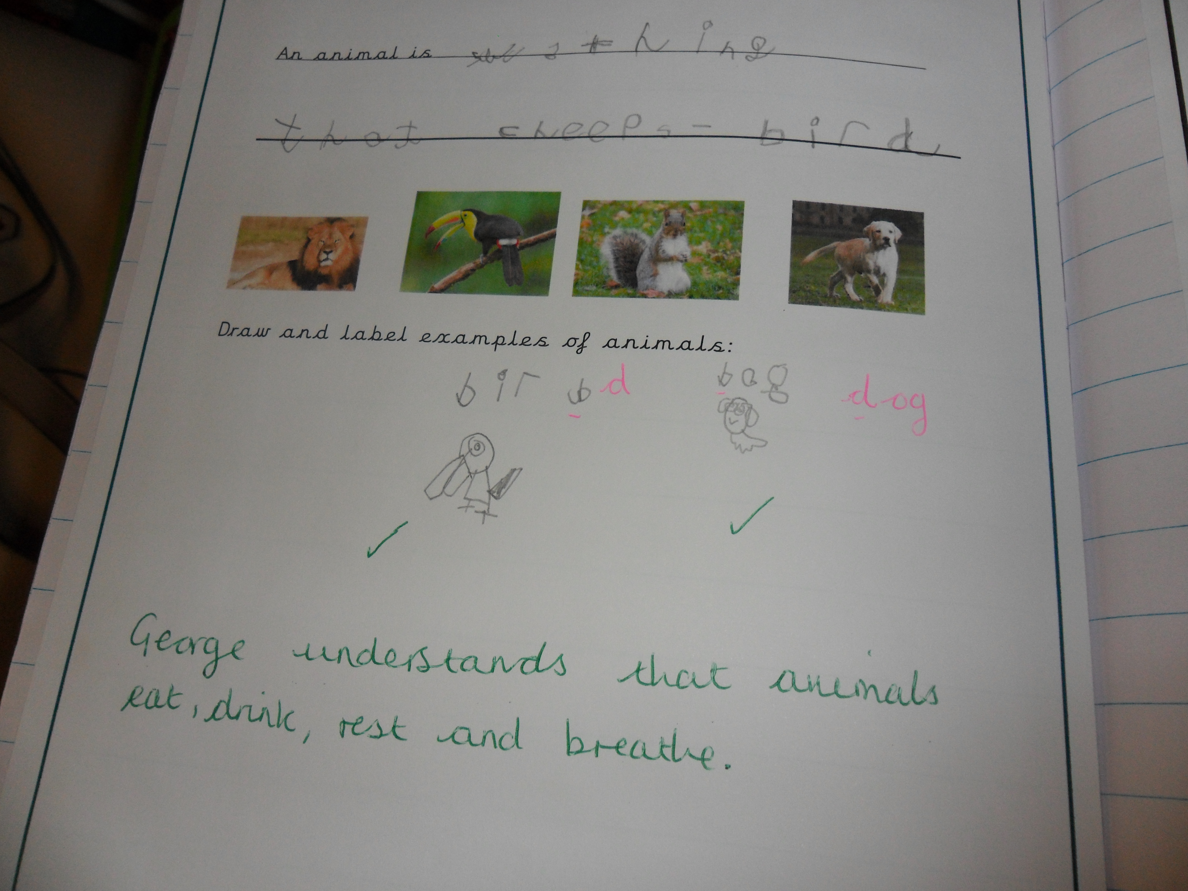
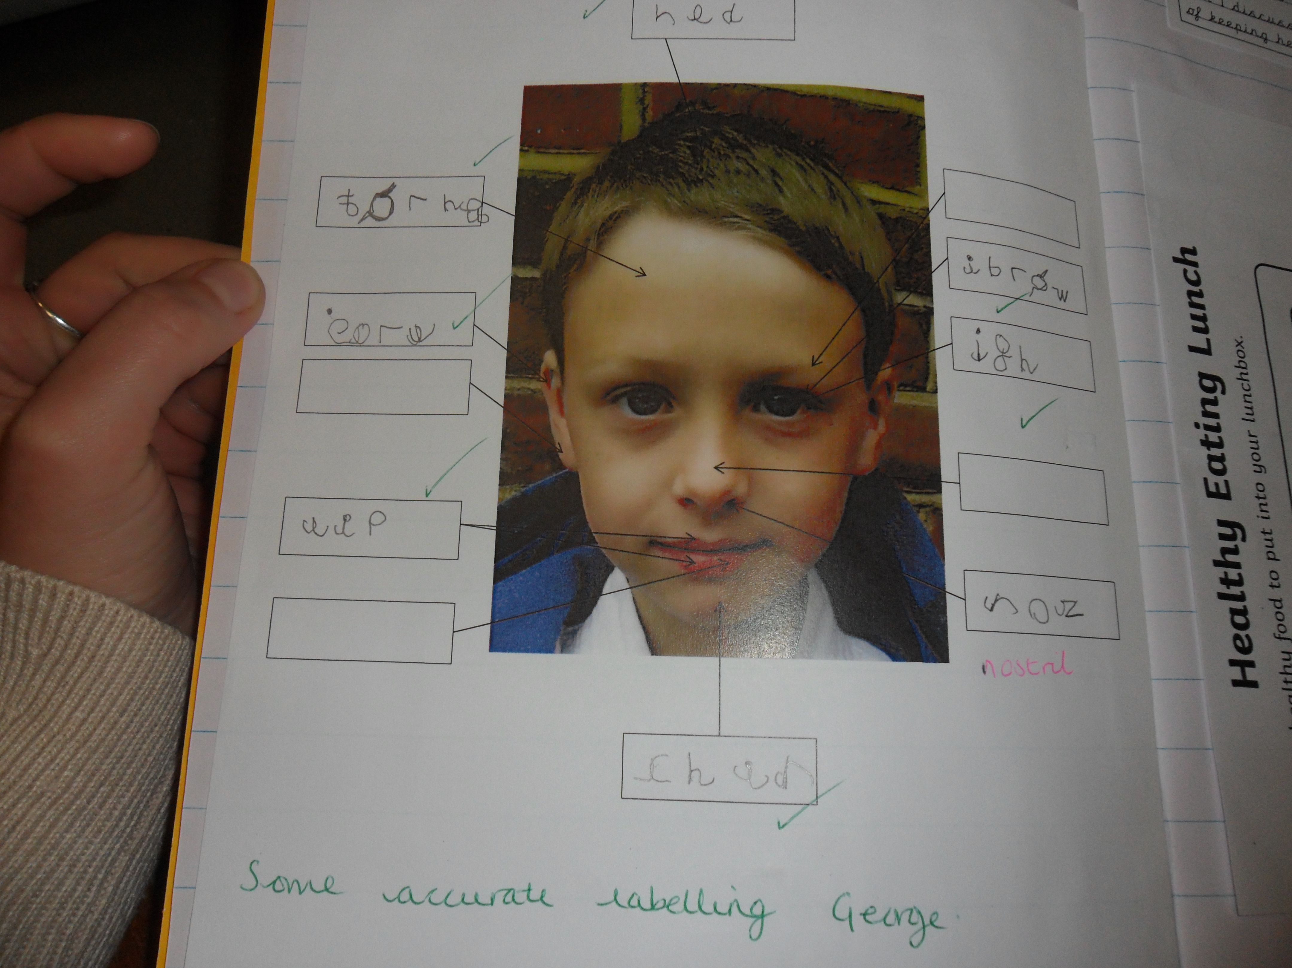
Marking
Marking in the science books follows our school policy- green presents a positive comment/response. Comments made in pink provide the children with a correction or a question to prompt further progress and development.

Slide 6
Assessment using skills progression ladder

Slide 7
STEM
What is STEM?
STEM is an acronym for science, technology, engineering and maths.
Why do we teach STEM at Cleobury?
We have been teaching STEM at Cleobury since 2016 and believe that it is vital in providing the opportunity for children to explore the wider world of science, and to prepare them for the world of work.

Slide 8
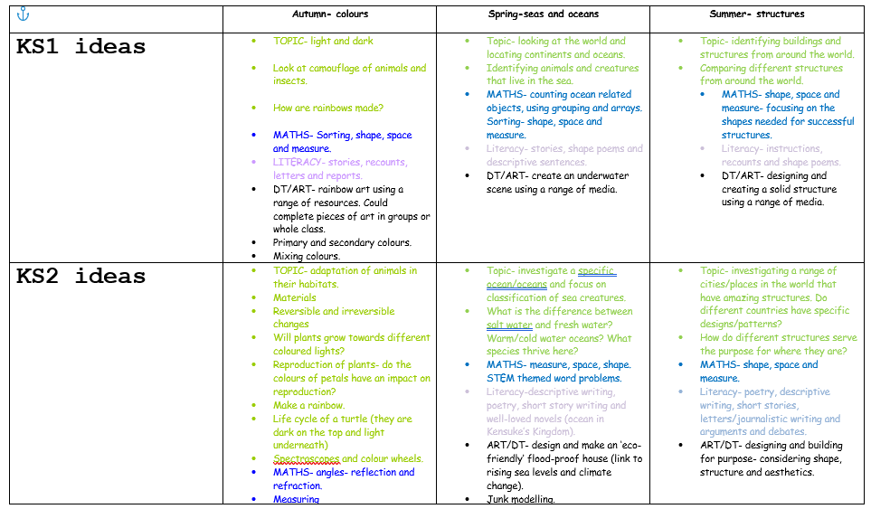
What does stem look like in our school?
Miss Snape plans STEM for the start of each academic year and send planning and suggestions for each key stage out to class teachers.

Slide 9
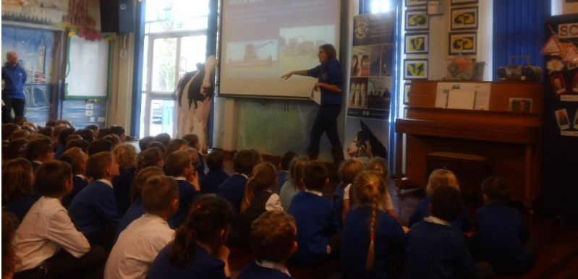
STEM is taught every term and the requirement is for class teachers to teach one or two afternoons of STEM during STEM week.
STEM week is often launched by a visitor or volunteer who come in and talk about how STEM works within their industry.
Here is Mrs Robinson from Mawley Town Farm giving a talk to the children about how the farm works.
Mr Robinson explained the science and technology behind modern day farming.
Other volunteers include a ‘Bee Lady’ from Bewdley and Hobsons Brewery!

Slide 10
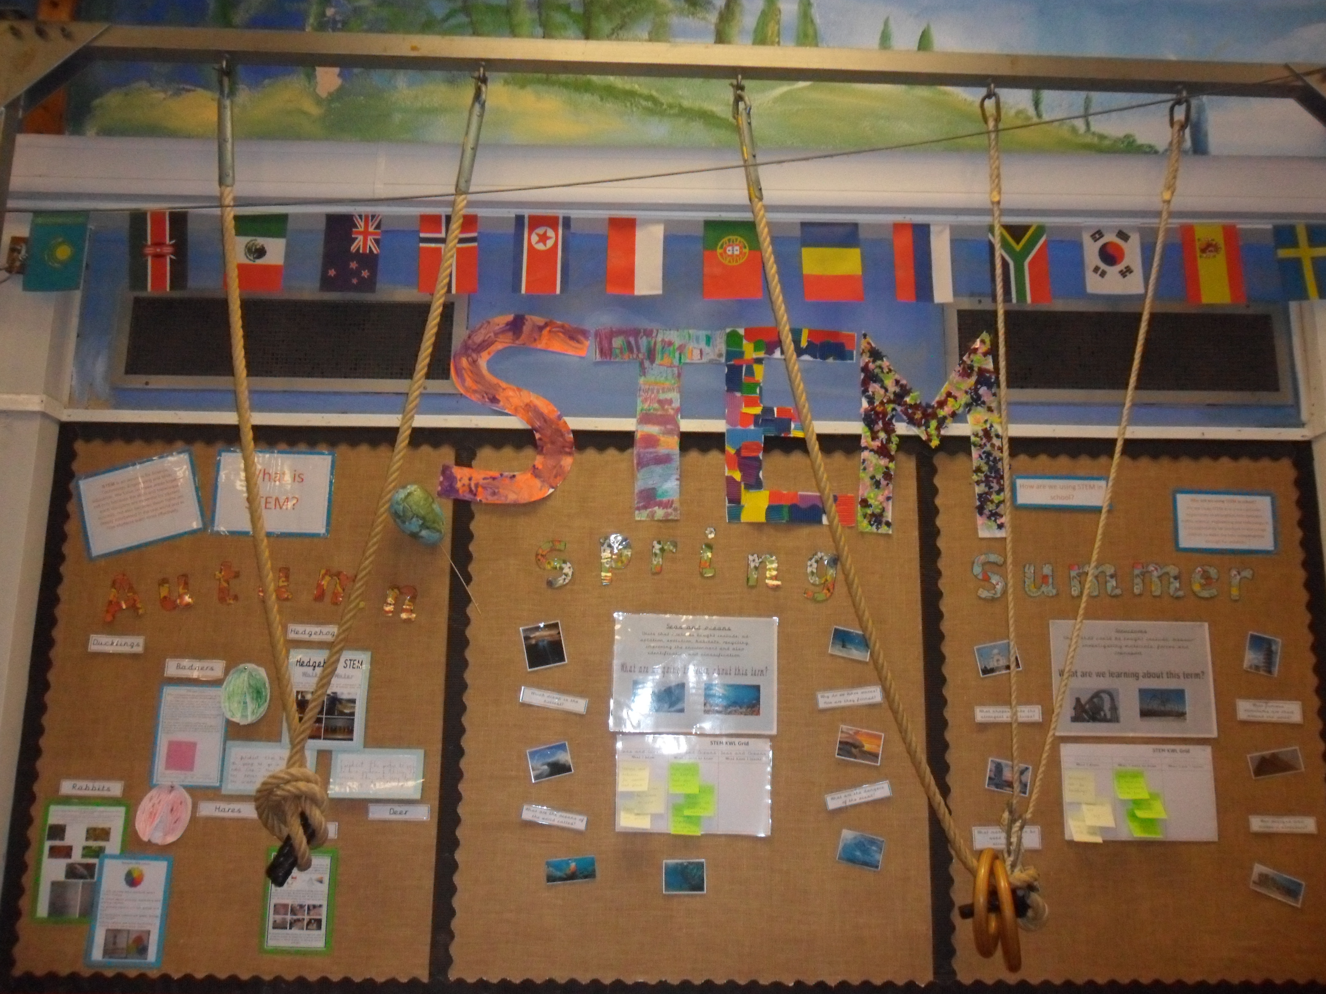
Evidence from STEM weeks are recorded in the children’s books and photographs and write-ups are then taken and used for our school STEM display (now in the hall).

Slide 11
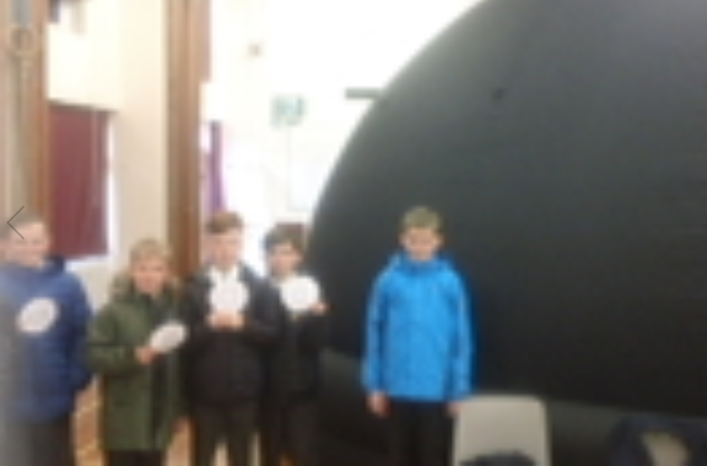
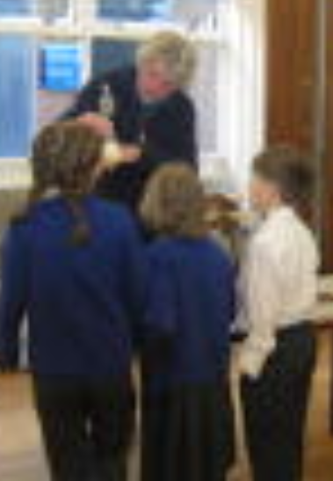
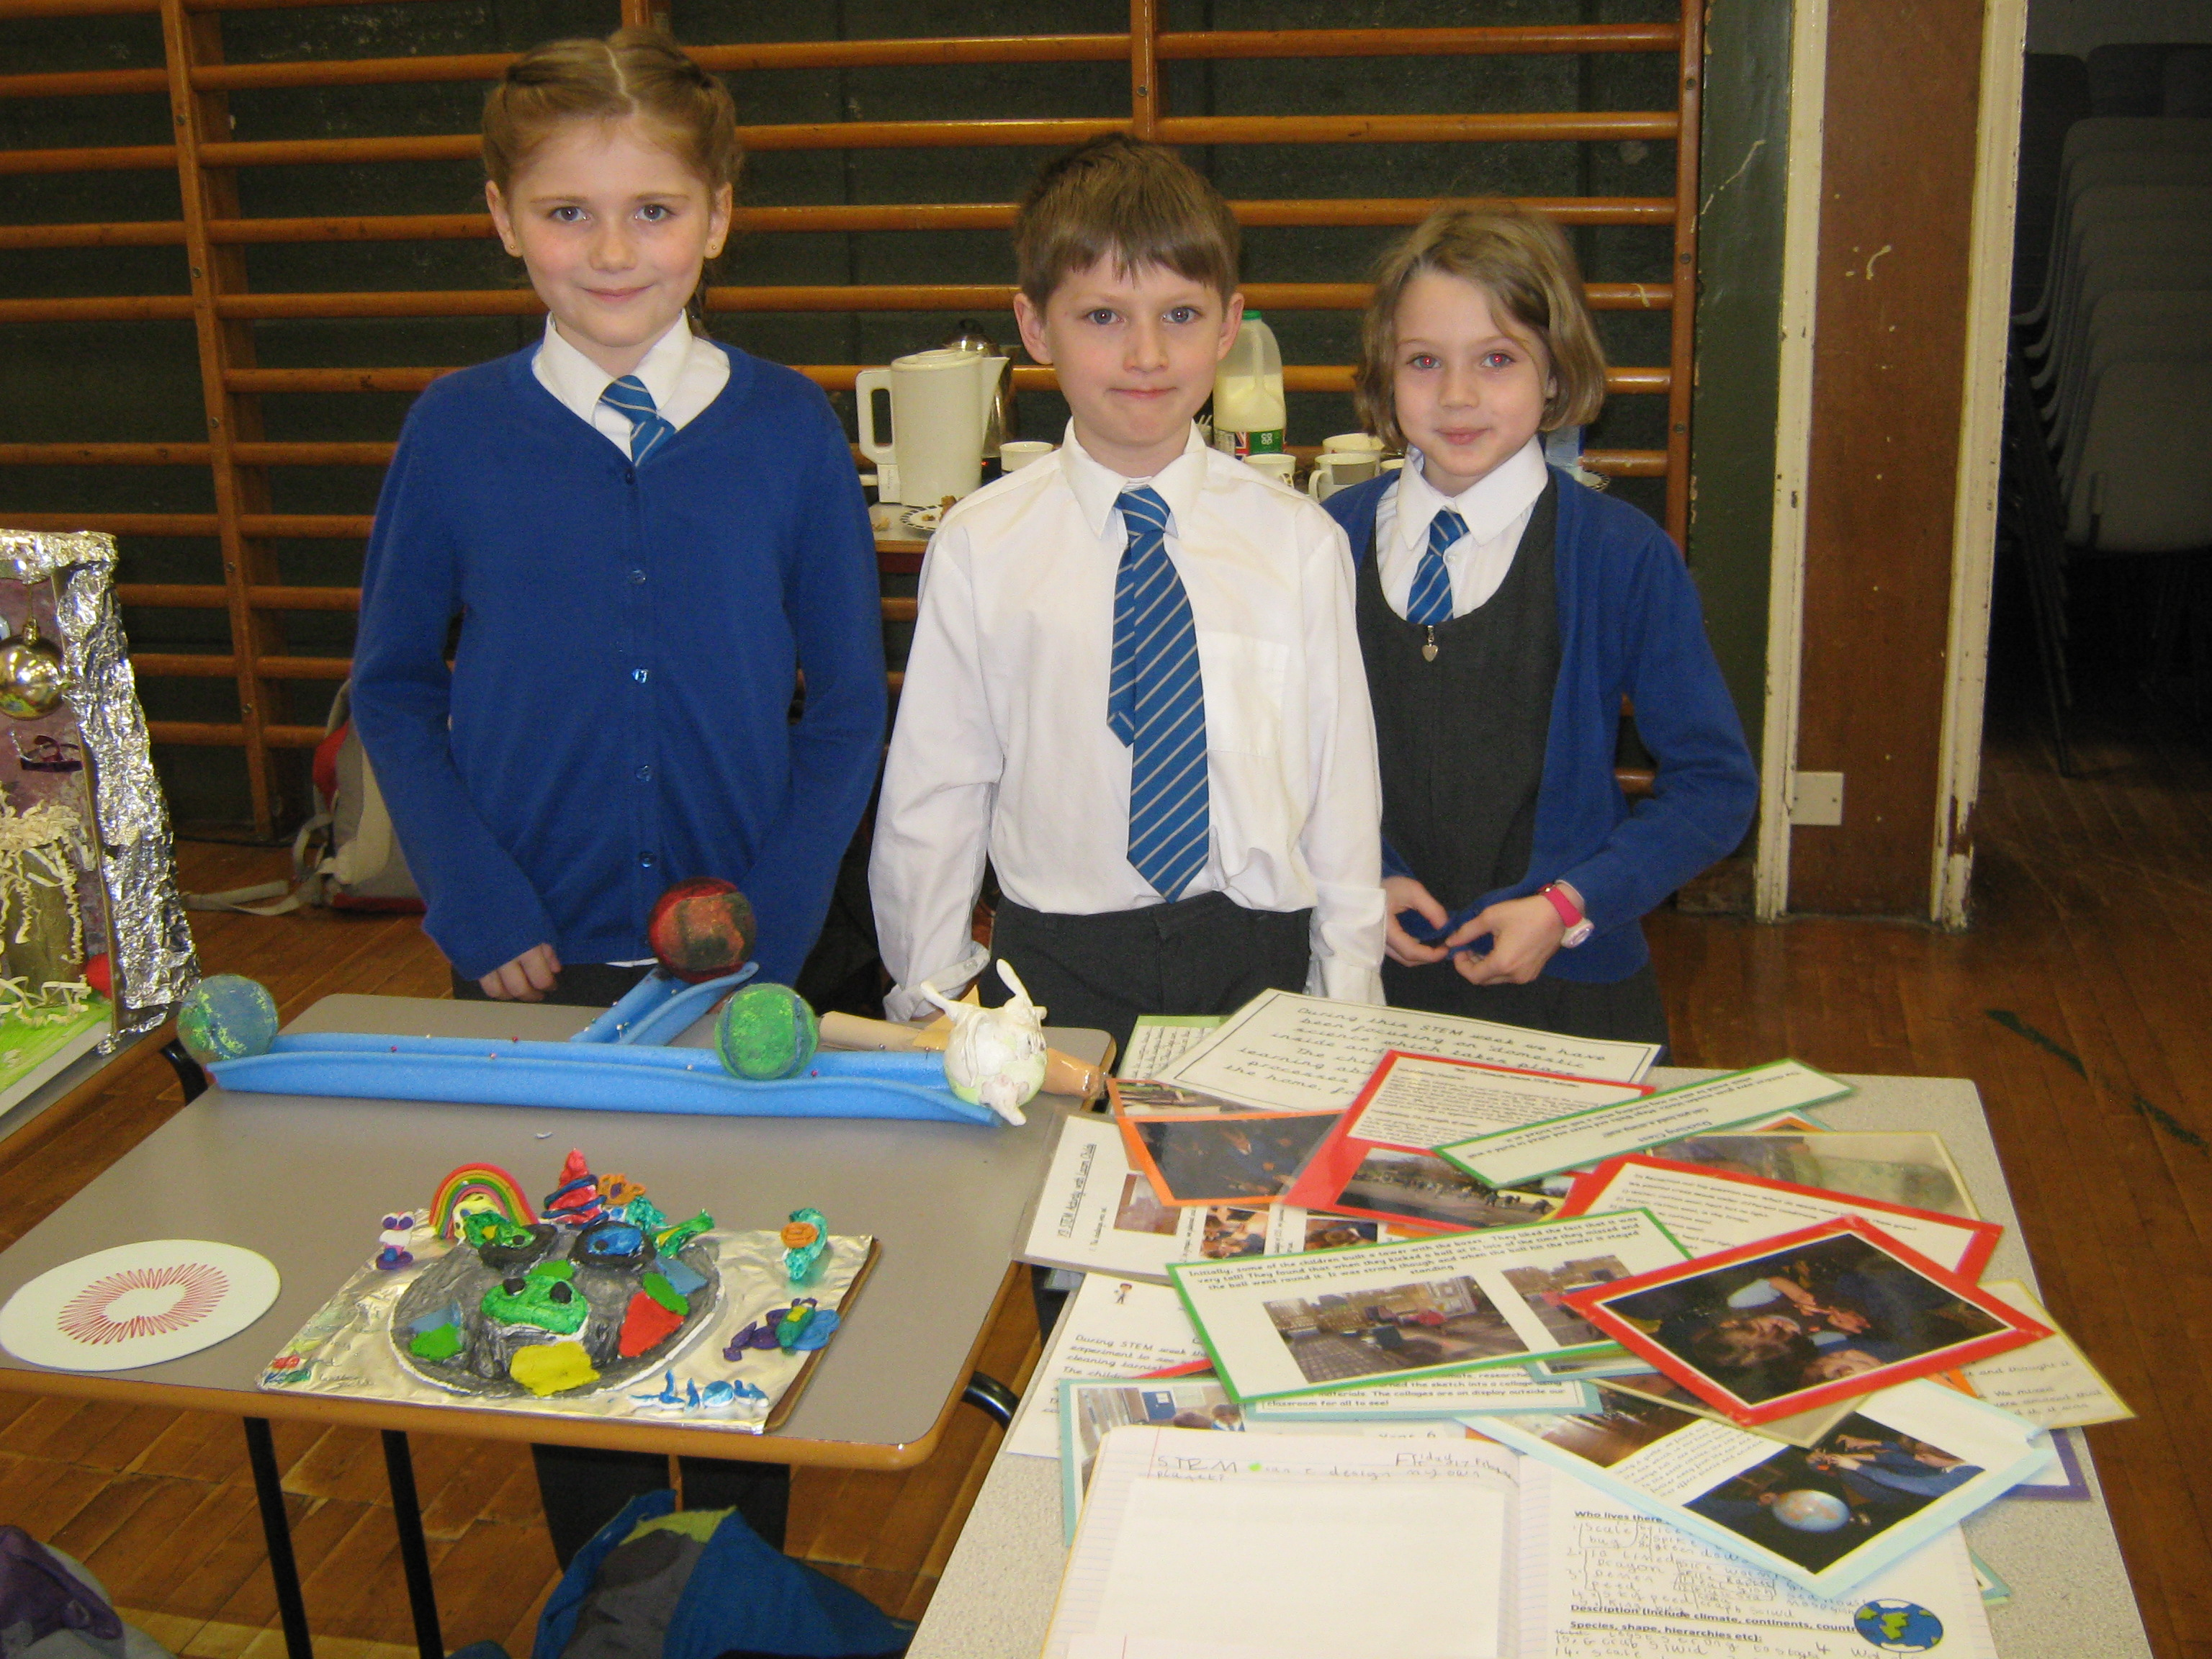
Other stem opportunities
We also have links with Lacon Childe, who plan and organise KS2 STEM lessons for the children to experience. The science teachers from Lacon have also been down to our school to deliver STEM assemblies, which have fascinated the children!
Lacon also provide us with the opportunity for y5 and y6 to attend an annual STEM fayre, where the children get to explore a variety of STEM based stalls, participate in activities and visit a planetarium.

Slide 12
Further development moving forward
What else would we like to achieve with STEM?
We would like to continue to provide the children with rich, engaging STEM opportunities within our school that enable the children to visualise their own futures.
Miss Snape would like to raise the profile of STEM in school, perhaps particularly for KS1, as I feel KS1 some times do not get all of the other opportunities provided for KS2. Miss Snape has asked Miss Johnston from Lacon to support our school with this and feel together we can come up with some good ideas to engage the KS1 children more.
As STEM co-ordinator, Miss Snape would like to plan and organise a STEM open afternoon for parents in the summer term, providing we can due to COVID. This would help to raise STEM awareness for parents and other members of the community, as well to continuing to develop relationships between parents and school.
I would like to continue building up a bank of contacts to support our school with STEM, as this would also help develop relationships between school and the wider community. If there is anything that you feel you could offer to support the STEM opportunities in out school then please get in touch!

